Slide 1


SAP CLOUD APPLICATION PROGRAMMING AND XSA TRAINING IN BTP
Anubhav Oberoy
Day – 10

Slide 2

Agenda – Day 10
Introduction to Generic Handlers

Slide 3
Generic Handlers
The CAPM Framework generates most of the code for CURDQ operations on the entity, it also does these operations in synchronous manner. At time, we want to
Take full control on CURDQ
I want to add my custom validations before data is updated
We want to change data with enrichment
Read data we want to add extra information
When? - on, before, after
Who? - ENTITY - Employee
Operation? – CREATE, UPDATE
What? – Validate if input Sal < 1mn
User/Developer
Service
CAPM Framework
DB
before
on
after

Slide 4
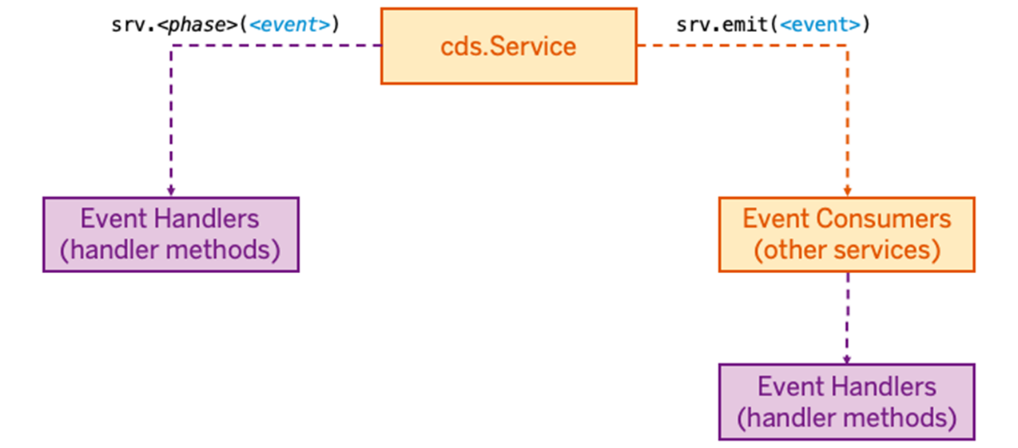
Event Handlers
Event Handler
In CAP everything that happens at runtime is an event that is sent to a service. They are a powerful means to extend CAP. An event handler is simply a method, that is executed when something happens in the application.
If you need a specific service to react to a specific event, you register an event handler using srv.<phase>(<event>), where
srv is the instance of the service that you are extending,
<phase> is one of on, before, or after
<event> is any kind of named event as a string (e.g. 'READ').
Once a service has an event handler for a specific event, it becomes a consumer for that event. Using srv.emit(<event>), a service can send arbitrary events. These events then get consumed by other services that have event handlers registered for the respective event.

Slide 5
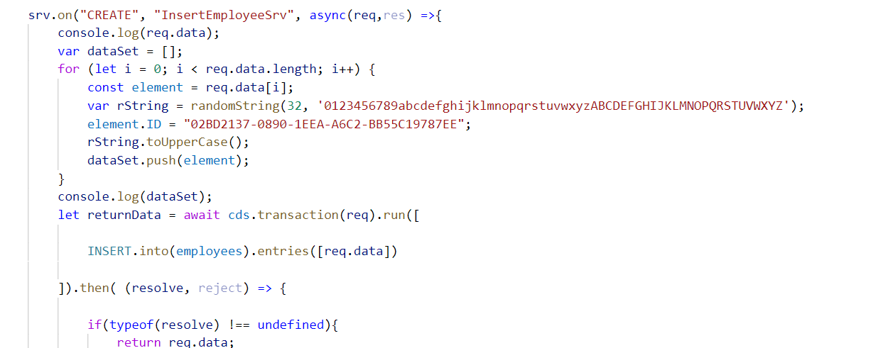
Hands-on: Event Handlers
To understand the concept of event handlers we will create a new service named mysimpleservice.cds and mysimpleservice.js to write the event handler code. In this exercise we will expose the employee set in different entity sets to perform different tasks.
Create two new files mysimpleservice.cds and mysimpleservice.js
Copy the code form below links and past it into the newly created files.
Run the project using cds run or cds watch command.
Test the operations from postman tool.
Exercise code/resource:-
mysimpleservice.cds
mysimpleservice.js

Slide 6
Error Handling
Content

Slide 7
Title
Content

Slide 8
Title
Content

Slide 9
Title
Content

Slide 10
Title
Content

Slide 11
Title
Content

Slide 12
Title
Content

Slide 13

End of Day 10

Slide 14

Questions

Slide 15

Anubhav Oberoy

Slide 16


We’re committed to empower you to be
Most Desirable Resource
through powerful training solutions.
We build the workforce of the future.
250+
Corporate Clients
30,000+
Learners Trained
25000+
Learners Placed
FREE WEBINARS
Sign up for free webinars with industry experts every fortnight!
Enroll Now!
Contact us today!
https://anubhavtrainings.com/

Slide 17




More from AnubhavTrainings.com

Slide 18
Title
Content

